Slide 1

Memory
Chris Piech
CS106A, Stanford University

Slide 2


Learning Goals
Be able to trace memory for objects

Slide 3

Warmup
*
* TSA says it was either $50k or $340k

Slide 4
Learn by Doing

Slide 5
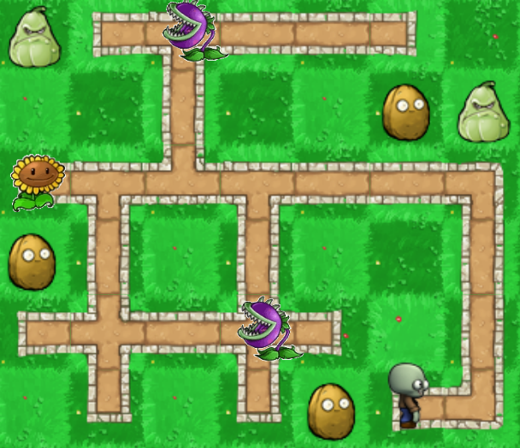
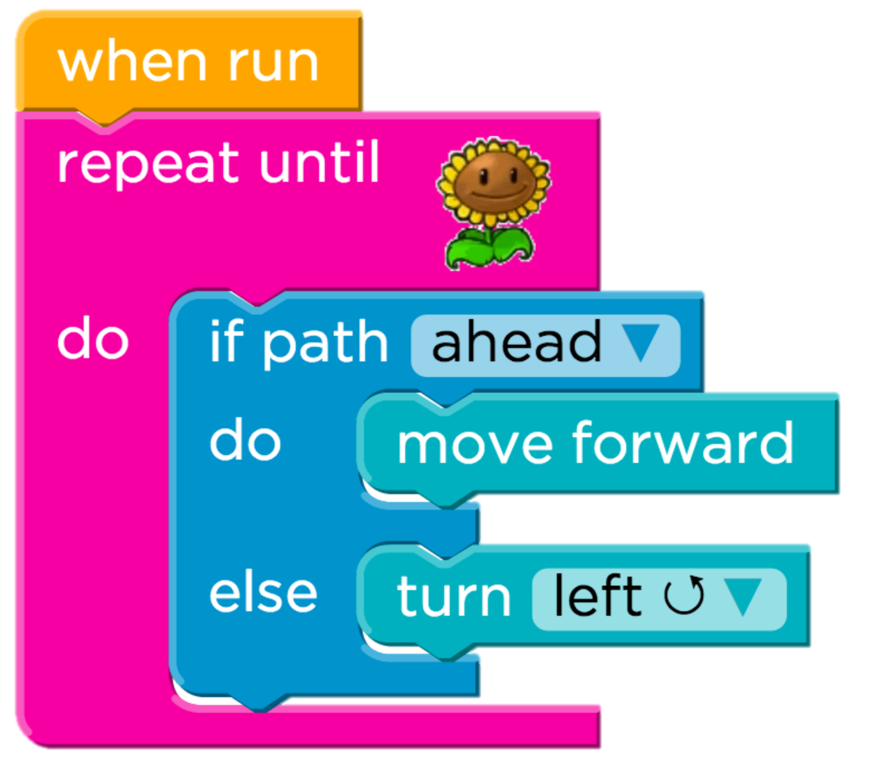
Learning to Program on the Internet
Task
Almost a hundred thousand unique solutions

Slide 6

US K-12 Students
= 500,000 learners

Slide 7
Code.org Students
= 500,000 learners

Slide 8
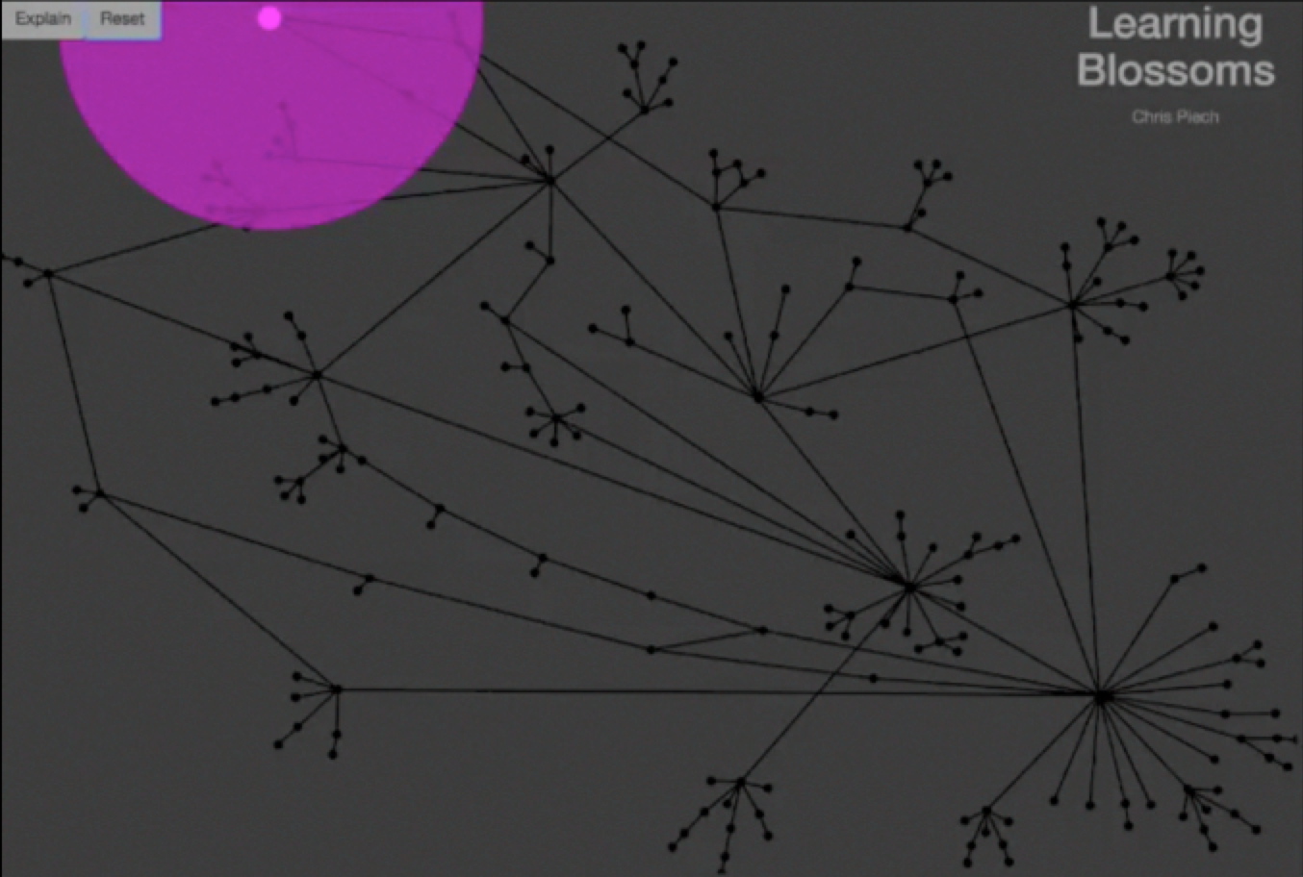
Autonomously Generating Hints by Inferring Problem Solving Policies - Piech, Sahami et al.

Slide 9
Each edge is what a teacher suggested
Pink dots are students.
Each node is a unique partial solution
Solution
Autonomously Generating Hints by Inferring Problem Solving Policies - Piech, Sahami et al.

Slide 10
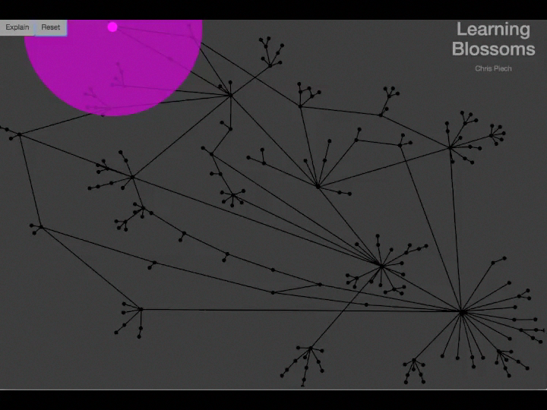
Autonomously Generating Hints by Inferring Problem Solving Policies - Piech, Sahami et al.

Slide 11
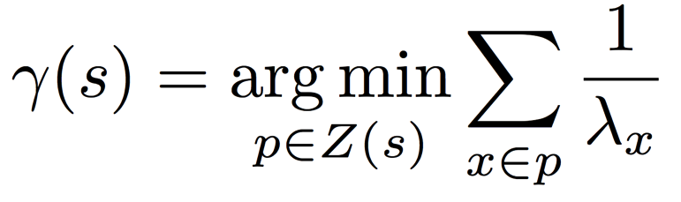
Desirable Path Algorithm
Poisson Common Path
Path Cost
Submission count of partial solution
Predicted next partial solution
Partial solutions in the path
Paths to solution
Notes:
Two algorithms
Both theoretically approximate what an average student would do from a state.
Both are closed form.
Look kinda similar ☺.

Slide 12
Predicts Future Success
How a student solves a problem predicts their future!
Problem A
Problem B
Effect is large and logrithmic.

Slide 13
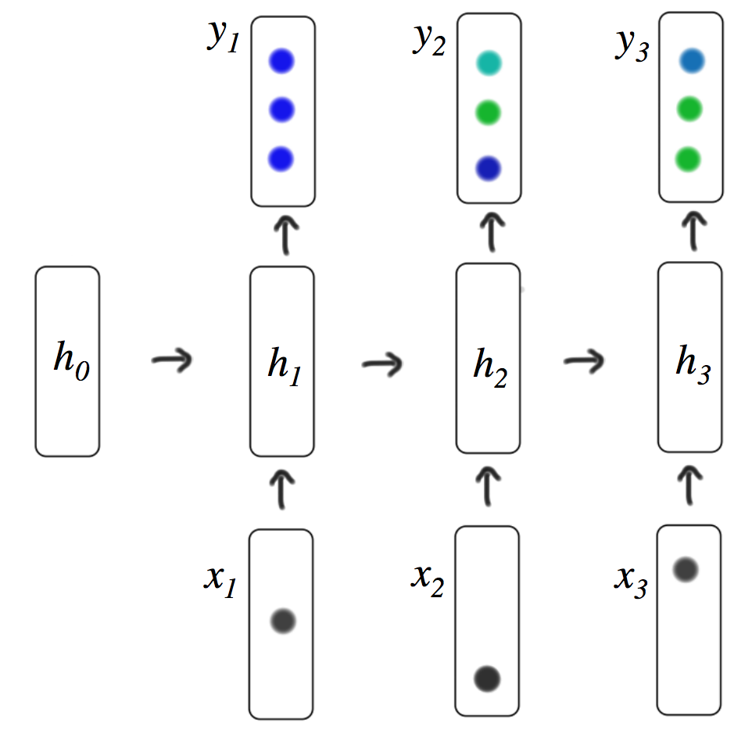



Deep Learning Algorithms
1
2
Program

Slide 14
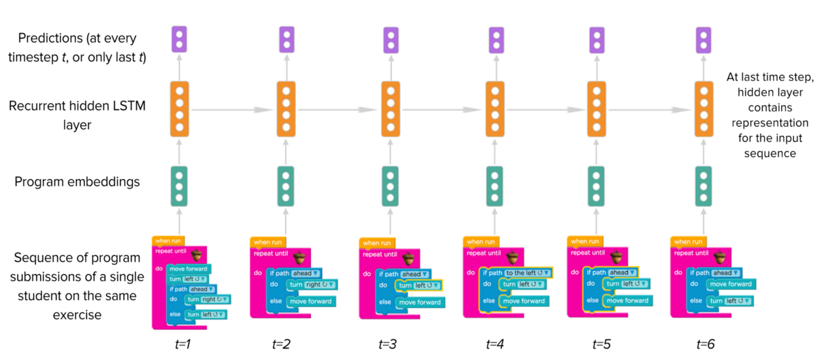
Deep Learning on Trajectories
Research in collaboration with Lisa Wang

Slide 15
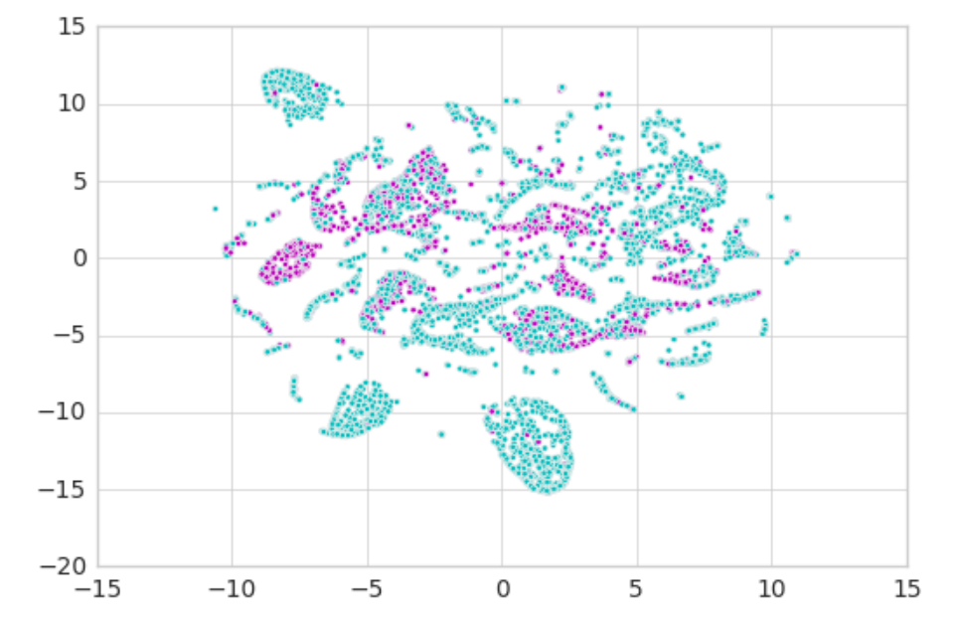
Deep Learning on Trajectories
Desirable Path

Slide 16
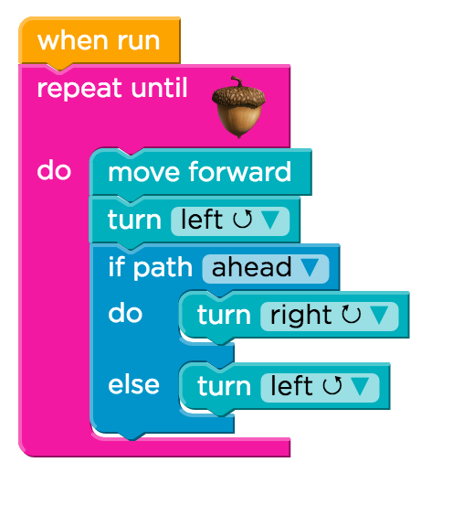
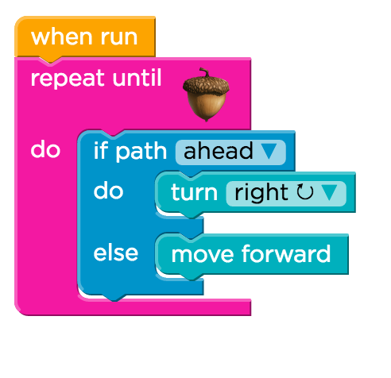
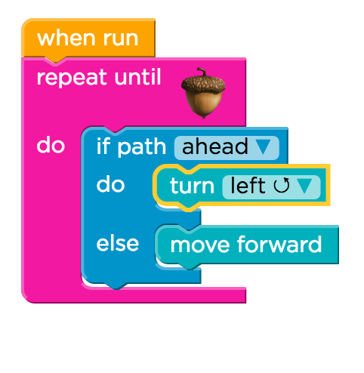
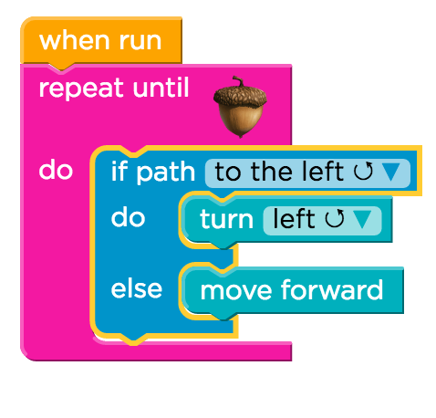
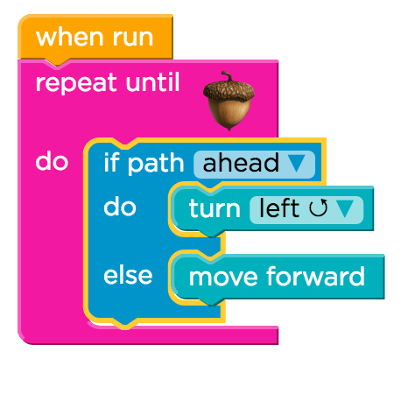
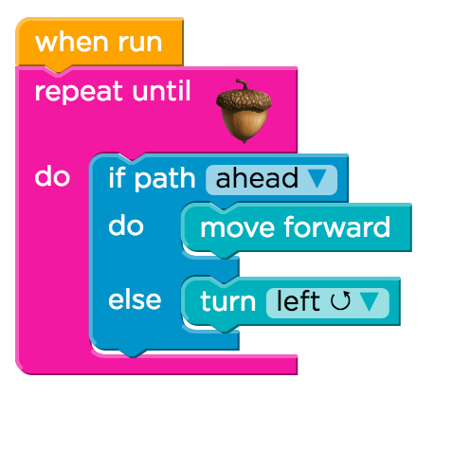
Highly Rates Grit
1. Two compound errors
2. Solves first error
3. Starts reasonable attempt
4. Completes attempt
5. Backtracks
6. Finds solution

Slide 17
Back to our regularly
scheduled programming

Slide 18
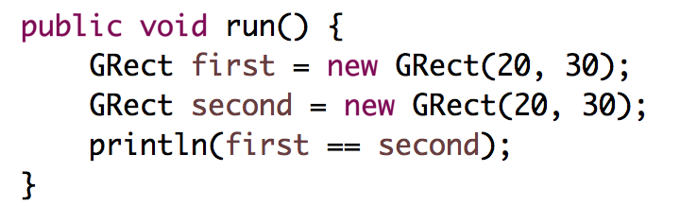
Who thinks this prints true?

Slide 19
Who thinks this prints true?
public void run() {
int x = 5;
int y = 5;
println(x == y);
}
Notes:
true

Slide 20
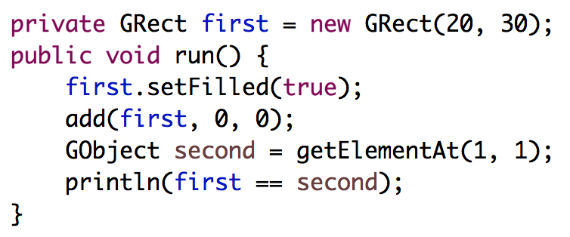
Who thinks this prints true?

Slide 21
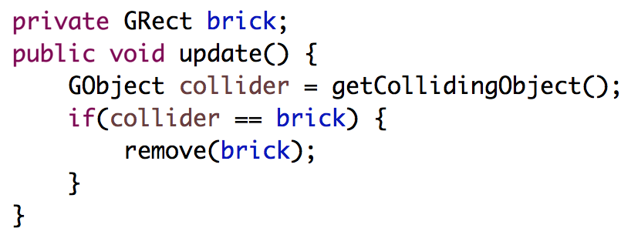
Deep Understanding is Key

Slide 22
[suspense]

Slide 23
Review

Slide 24
Primitives vs Classes
Primitive Variable Types
Class Variable Types
int
double
char
boolean
GRect
GOval
Gline
Color
Class variables (aka objects)
Have upper camel case types
You can call methods on them
Are constructed using new
Are stored in a special way

Slide 25
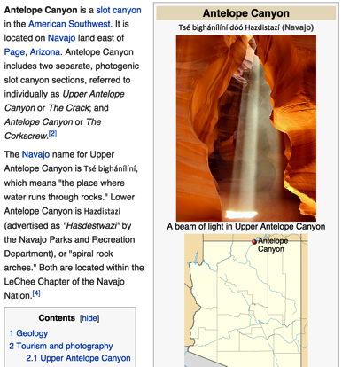
How do you share wikipedia articles?
Antelope Canyon Article
Key:
https://en.wikipedia.org/wiki/Antelope_Canyon

Slide 26
What does an object store?

Slide 27
Objects store addresses
(which are like URLs)

Slide 28
public void run() {
GRect r = null;
}
stack

Slide 29
public void run() {
GRect r = null;
}
stack
run
r
null

Slide 30
Wahoo!

Slide 31
public void run() {
GRect r = new GRect(50, 50);
}
Method Memory
Object Memory
run

Slide 32
public void run() {
GRect r = new GRect(50, 50);
}
stack
heap
run
18

Slide 33
public void run() {
GRect r = new GRect(50, 50);
}
stack
heap
run
18
r
18

Slide 34
public void run() {
GRect r = new GRect(50, 50);
}
stack
heap
run
memory.com/18
r
memory.com/18

Slide 35
public void run() {
GRect r = new GRect(50, 50);
}
stack
heap
run
18
r
18

Slide 36
public void run() {
GRect r = new GRect(50, 50);
r.setColor(Color.BLUE);
r.setFilled(true);
}
stack
heap
run
18
r
18

Slide 37
public void run() {
GRect r = new GRect(50, 50);
r.setColor(Color.BLUE);
r.setFilled(true);
}
stack
heap
run
18
r
18

Slide 38
public void run() {
GRect r = new GRect(50, 50);
r.setColor(Color.BLUE);
r.setFilled(true);
}
stack
heap
run
18
r
18

Slide 39
#1: new allocates memory on the heap

Slide 40
#2: object variables store heap addresses
#ultimatekey

Slide 41
End Review

Slide 42
What does an object store?

Slide 43
Objects store addresses
(which are like URLs)

Slide 44
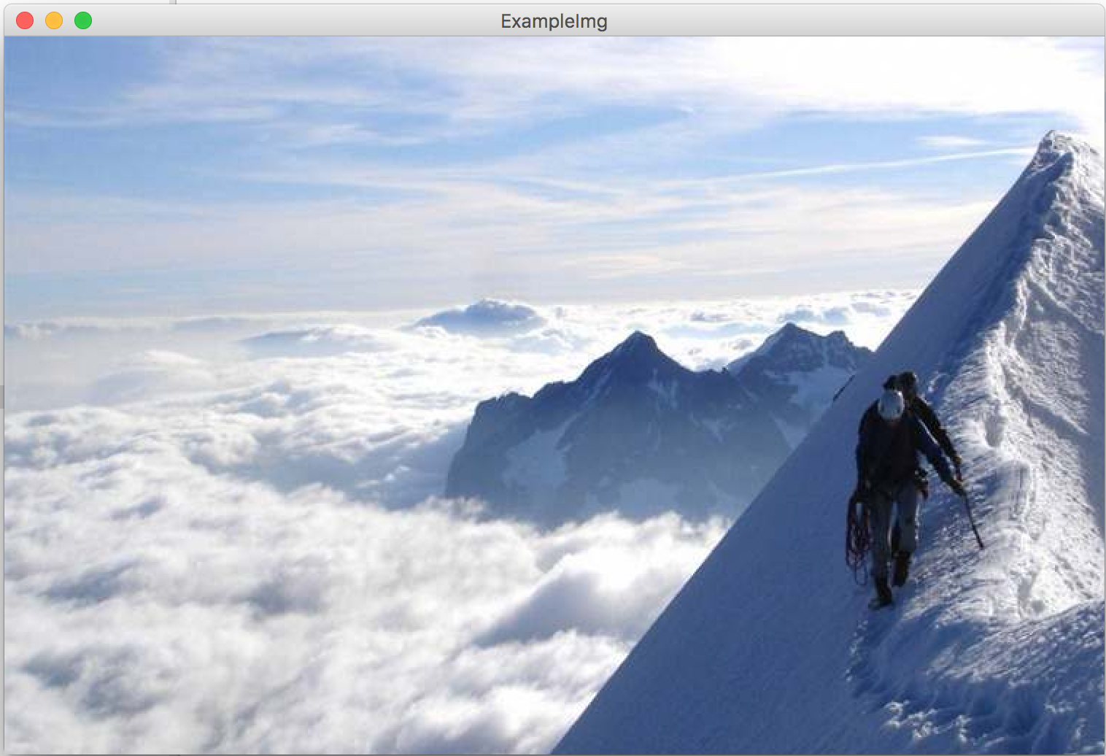
public void run() {
GImage img = new GImage(”mountain.jpg”);
add(img, 0, 0);
}
stack
heap
run
img

Slide 46
#3: GImages look impressive but don’t take much extra work

Slide 47
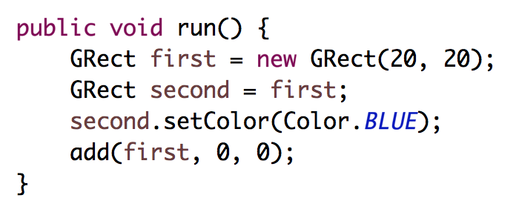
stack
heap
run
first
second

Slide 48
stack
heap
run
32
first
second

Slide 49
stack
heap
run
32
first
32
second

Slide 50
stack
heap
run
32
first
32
second

Slide 51
stack
heap
run
32
first
32
second
32

Slide 52
stack
heap
run
32
first
32
second
32

Slide 53
stack
heap
run
32
first
32
second
32

Slide 54
#4: when you use the = operator with objects, it copies the address

Slide 55
What does an object store?

Slide 56
Objects store addresses
(which are like URLs)

Slide 57
Passing by “Reference”

Slide 58
Primitives pass by value
// NOTE: This program is buggy!!
public void run() {
int x = 3;
addFive(x);
println("x = " + x);
}
private void addFive(int x) {
x += 5;
}
* This is probably the single more important example to understand in CS106A

Slide 59
Objects pass by reference
// NOTE: This program is awesome!!
public void run() {
GRect paddle = new GRect(50, 50);
makeBlue(paddle);
add(paddle, 0, 0);
}
private void makeBlue(GRect object) {
object.setColor(Color.BLUE);
object.setFilled(true);
}
* This is probably the single more important example to understand in CS106A

Slide 60
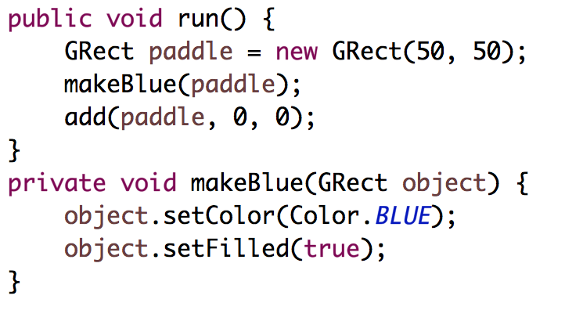

Slide 61
stack
heap
run
paddle

Slide 62
stack
heap
run
18
paddle
18

Slide 63
stack
heap
run
18
paddle
18
makeBlue
object

Slide 64
stack
heap
run
18
paddle
18
makeBlue
object
18

Slide 65
stack
heap
run
18
paddle
18
makeBlue
object
18

Slide 66
stack
heap
run
18
paddle
18
makeBlue
object
18

Slide 67
stack
heap
run
18
paddle
18
makeBlue
object
18

Slide 68
stack
heap
run
18
paddle
18
makeBlue
object
18

Slide 69
stack
heap
run
18
paddle
18

Slide 70
#5: when you pass (or return) an object, the address is passed.
Aka reference

Slide 71
What does an object store?

Slide 72
Objects store addresses
(which are like URLs)

Slide 73
Instance Variables

Slide 74
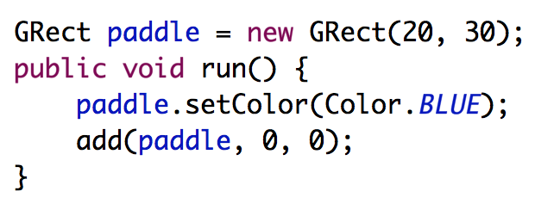
heap
Instance Variables

Slide 75
heap
Instance Variables
18
paddle
18

Slide 76
heap
Instance Variables
18
paddle
18
run

Slide 77
heap
Instance Variables
18
paddle
18
run

Slide 78
#7: there is space for all instance variables. They are accessible by the entire class

Slide 79
#8: instance variables are initialized before run is called

Slide 80
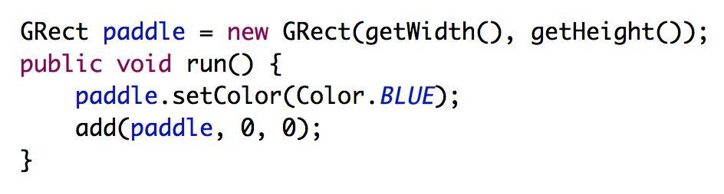
Common Bug
Question: what does this program do?
Answer: makes a square that is 0 by 0 since getWidth is called before the screen has been made.

Slide 81
Canvas
(and getElementAt)

Slide 82
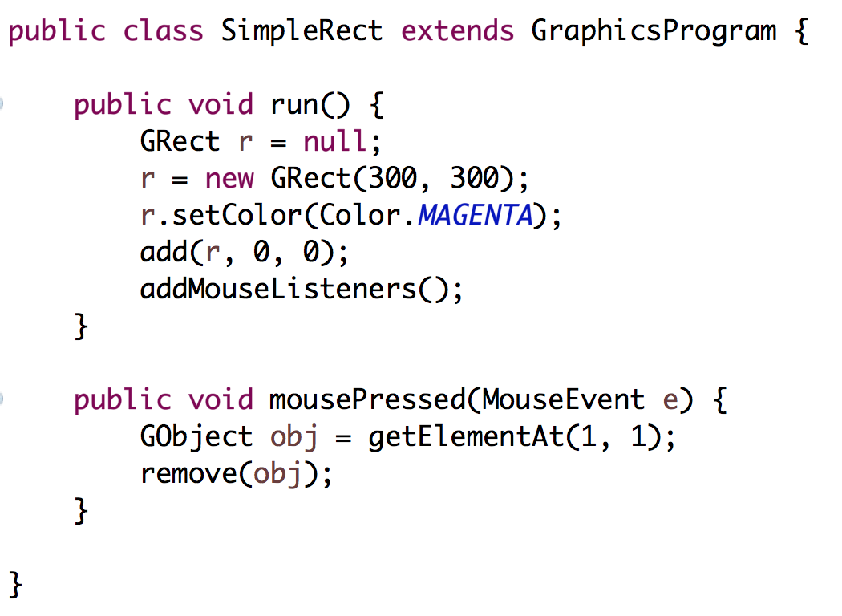

Slide 83
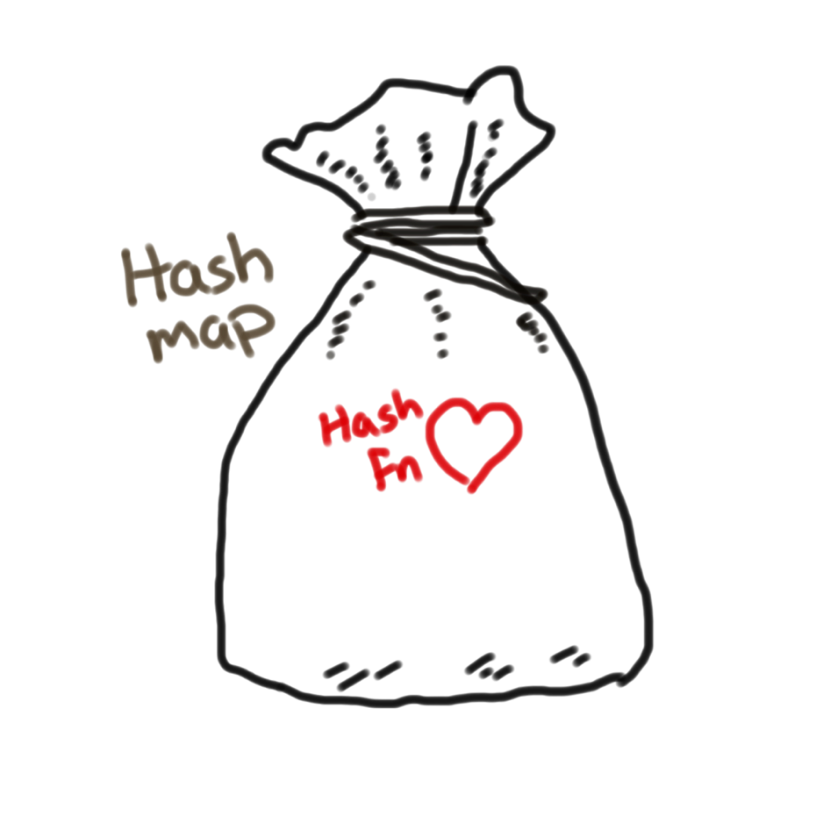
Canvas
Heap
Instance Variables
12
canvas
12
run
r
12

Slide 85
Canvas
Heap
Instance Variables
12
canvas
94
mousePressed
e
94
x = 72
y = 94
time = 192332123
obj
12

Slide 86
#6: graphics programs all have an instance variable “canvas” which keeps track of the objects on the screen

Slide 87
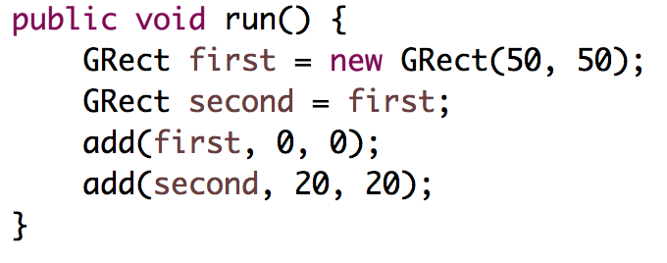
Intentionally left blank so that we can fill it in during lecture

Slide 88



Today’s Route
You are here
Friday
Instance
Variables
Canvas
The Heap
Core model
The River of Memories

Slide 89
#9: for objects == checks if the variables store the same address

Slide 90
Recall the start of class?

Slide 91
Who thinks this prints true?

Slide 92
Who thinks this prints true?
public void run() {
int x = 5;
int y = 5;
println(x == y);
}
Notes:
true

Slide 93
Who thinks this prints true?

Slide 94
What does an object store?

Slide 95
Objects store addresses
(which are like URLs)

Slide 96
Primitives vs Objects
Primitives store their actual value in their variable box. You can compare values with == and !=, and the original does not change when passed as a parameter and changed.
Objects store their address in their variable box. You can’t compare properties of an object via ==, and the original does change when passed as a parameter and changed.
Primitives are passed by value, Objects are passed by reference

Slide 97
Learning Goals
Be able to trace memory for objects

Slide 98
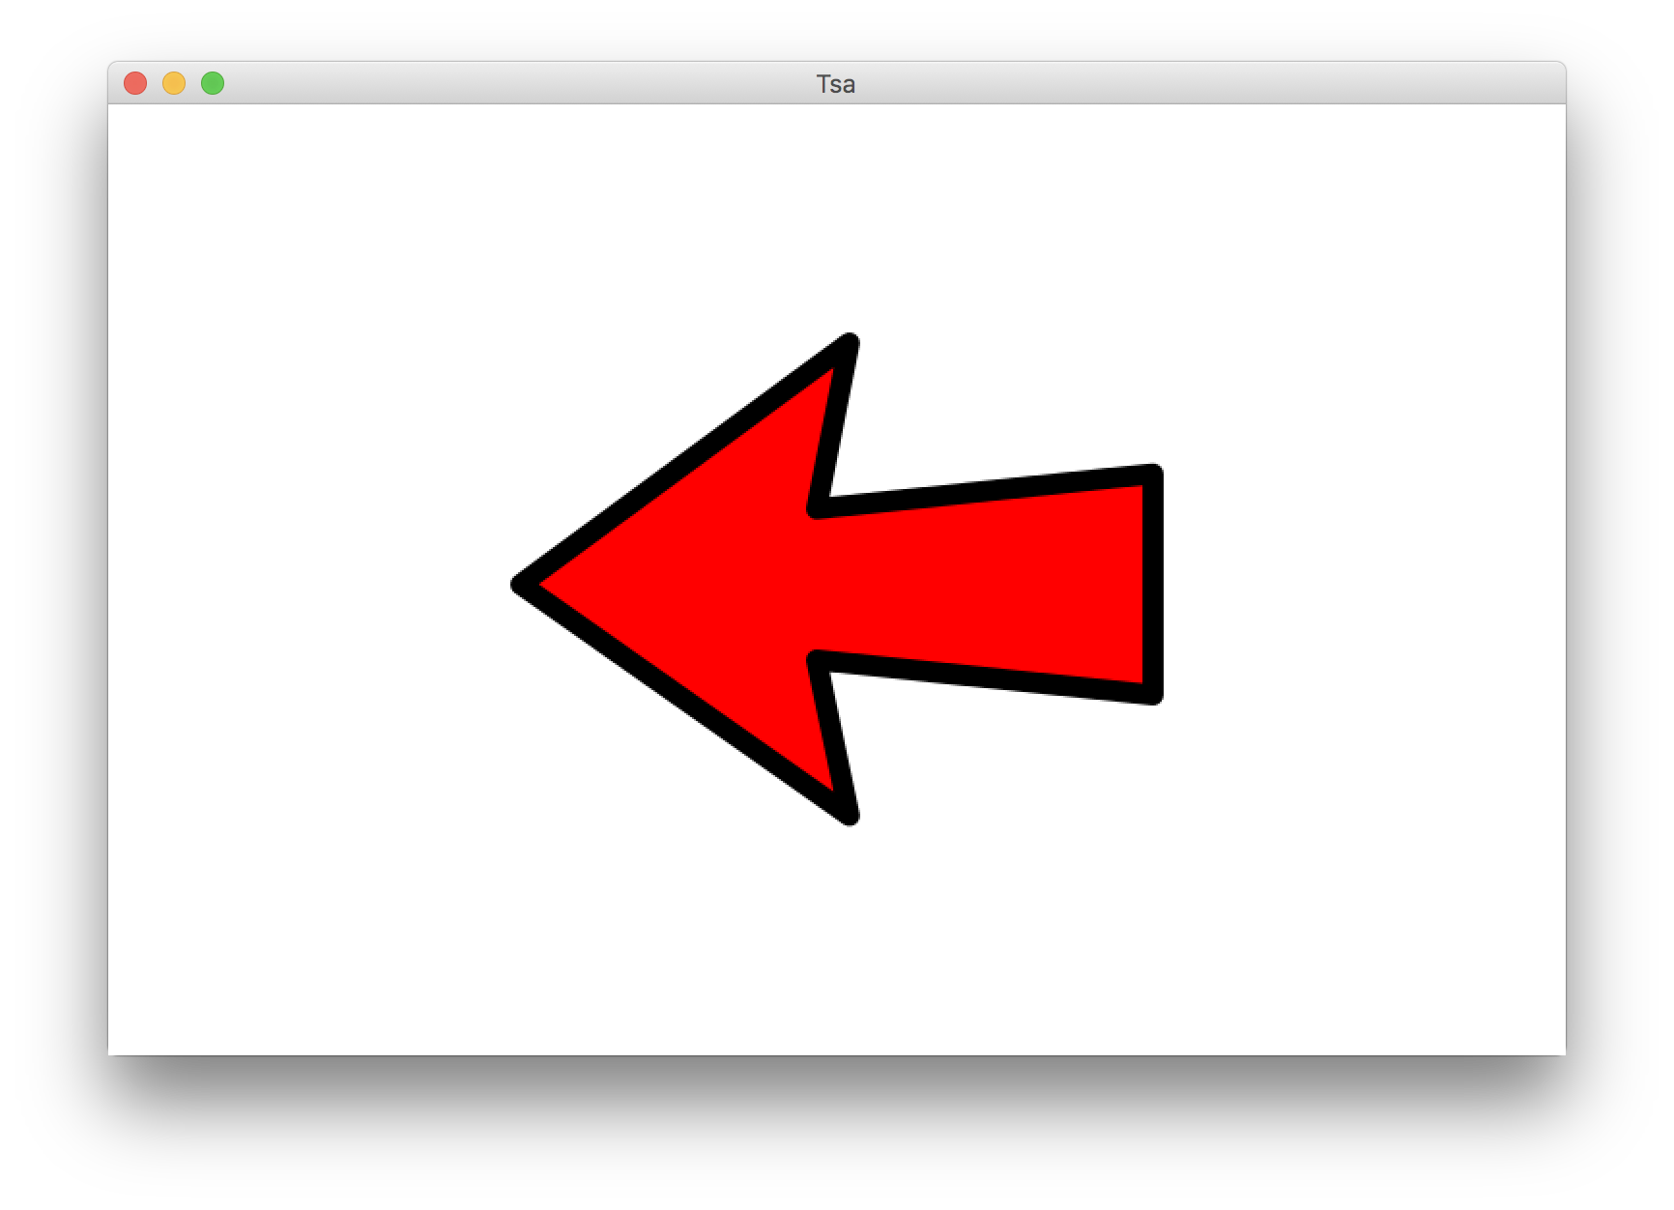
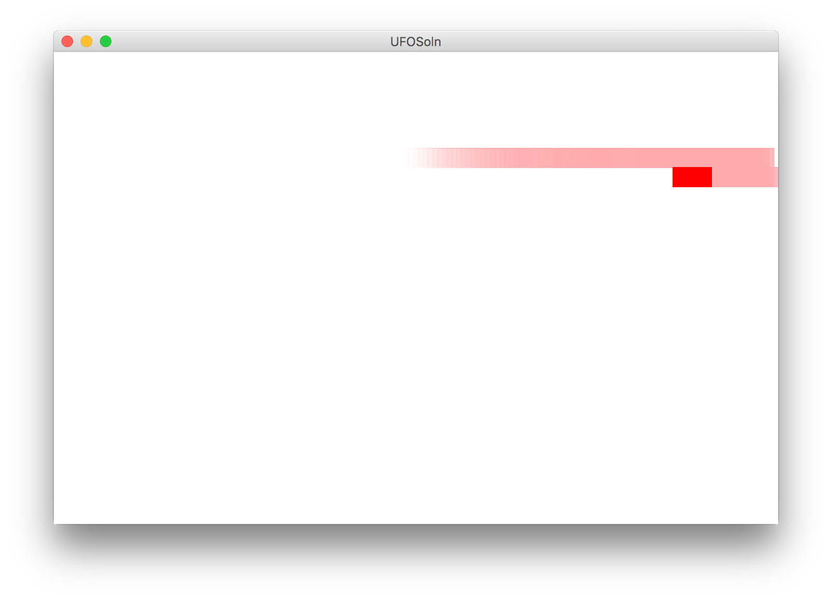
Revisit our Programs

Slide 99
Beyond CS106A
Heap
run
12
this
76
r
12
76
MyGraphicsProgram
Methods store a lot of extra information. They contain a “this” pointer which points to a space on the heap where the instance variables live. They have a variable that remembers which line was last executed and they store information about who called the current method.
canvas
12

